Slide 1

5th module Computer Communication Networks E-MAIL
- Architecture of E-mail - User Agent

Slide 2
What is E-mail
Email is short for ‘Electronic mail’ and was designed as a program used to exchange messages that are stored within a computer. In terms of the programming, these are usually encoded using ASCII text. However, in most cases, a user can also send non-text files such as images, videos, and sound files through the mail as attachments.
Email can be used in a variety of ways, either personally or within an organization, as well as one on one or among a large group of people.

Slide 3
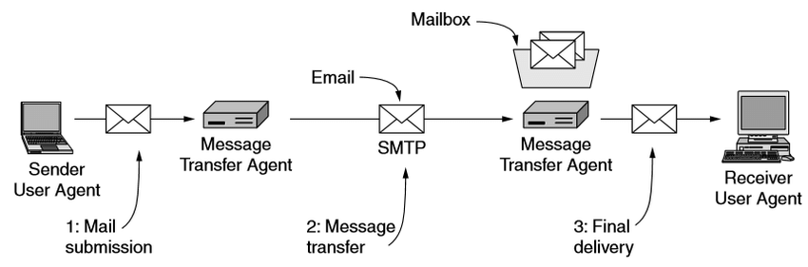
Architecture of Email

Slide 4
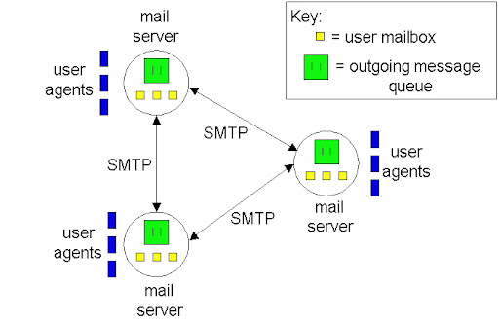
User-agent

Slide 5
User-agent
Generally, User Agent is a program that provides a graphical or command based interface that lets users interact with the email system. User agent provides you to the ability to compose message and their replies, display incoming messages, and organize message by filling, searching, and discarding them. The act of sending new messages into the mail system for delivery is called mail submission.
The User-Agent sub-system does automatically filtered incoming mail packets according to its type, such as social, updates, primary, promotions, spams etc. These are the different types of mail messages coming from different sources.

Slide 6
User-agent
Some advance User-Agent provides an advanced facility for us to send automatic reply responses to all mail senders. If we say in other words, Advance User-Agent generates automatically reply responses according to mail sender’s message without any user interaction. This feature is helpful for those peoples who want to give specific replies to all the senders.
There are many popular user-agents, including Google Gmail, Microsoft Outlook, Mozilla Thunderbird, and Apple Mail.
These sub-systems are the basic or fundamental parts of the Email System. User Agent and Message transfer Agent both are the building blocks of E-mail System.

Slide 7
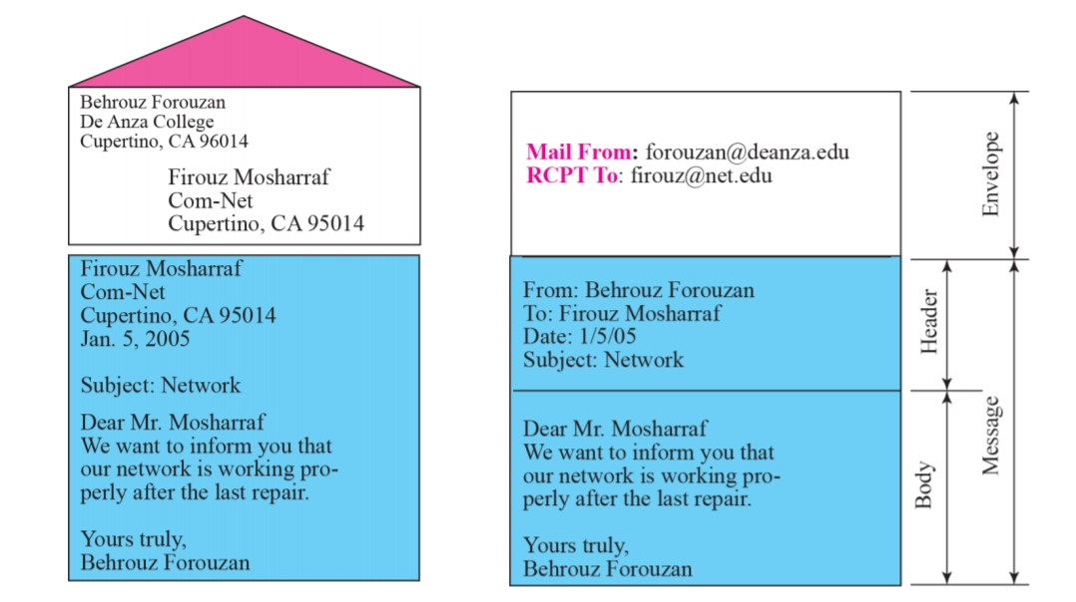
Format of an email

Slide 8
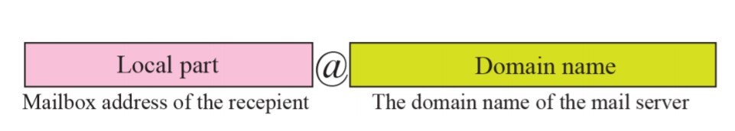
E-mail address

